Slide 1
CHAP TER 7: SOCIAL ISSUES
DR. ROZI NOR HAIZAN BINTI NOR

Slide 2
Contents
Green Computing
Digital Divide
Work Environment
Social media network

Slide 3
Objectives: Green Computing
Consider the following questions:
What is green computing?
What are organizations doing to support this initiative?
What are the pathways to green computing?

Slide 4
Green Computing
Green computing is the environmentally responsible and eco-friendly use of computers and their resources.
In broader terms, it is also defined as the study of designing, manufacturing/engineering, using and disposing of computing devices in a way that reduces their environmental impact.
Uses less electricity to run, thus its carbon footprint on the planet is smaller

Slide 5
How IT industry can Harm Environment?
Consuming resources - Non-renewable resources, including precious metals like gold, are used to make technology. Many others, such as coal, are consumed to generate the electricity to use technology. Even some renewable resources, like trees and water, are becoming contaminated or are used up faster than they can renew themselves because of technology.
Waste - Manufacturing technology creates large amounts of waste, and used computers and electronics get thrown out when they break or become outdated. Called "technotrash," these electronics contain all sorts of hazardous materials that are very unsafe for the environment. They need to be disposed of using special methods.
Health hazards - Using toxic materials that can harm our health can cause cancer, and technology addiction can lead to other health problems.

Slide 6
How IT industry can Harm Environment?
Carbon emissions, mostly carbon dioxide and carbon monoxide, are greenhouse gasses that are produced by people. Greenhouse gasses are gasses in the atmosphere that trap and reflect heat and radiation back to the planet's surface. It is believed that over the last century, the amount of greenhouse gasses in the atmosphere has increased due to carbon emissions, and that they are contributing to global warming.
Carbon emissions get released into the atmosphere from things like cars, air planes, power plants and factories. They also get released by people like you, when you use a vehicle or electricity created from burning fossil fuels. The computer you're using to read this is using electricity, and so is your mobile device and video game system. We're all guilty of enjoying things that aren't exactly eco-friendly, but if we're smarter about how we use technology, we can reduce our environmental impact.
The amount of carbon dioxide and other carbon compounds emitted due to the consumption of fossil fuels by a particular person, group, etc.

Slide 7
How IT industry can Harm Environment?
Technotrash, also called electronic waste or e-waste, is any broken or unwanted electrical or electronic device, and is currently the most rapidly-growing type of waste.
If you just throw away technotrash with the regular trash, it usually ends up in a landfill.
Most electronics contain non-biodegradable materials, and heavy metals and toxic materials like cadmium, lead and mercury. Over time, these toxic materials can leak into the ground, where they can contaminate the water we drink, the plants we eat and the animals that live around the area.
These toxic materials can cause all kinds of bad effects including nausea, diarrhea, vomiting and even cancer.

Slide 8
The Goal of Green Computing
Reduces the use of hazardous materials, maximise energy efficiency during the product’s lifetime, and to promote recyclability and biodegradability of defunct product and factory usage

Slide 9
Green Computing
To manufacture truly “green” products, companies must:
Produce product that requires less electricity
Reduce the number of hazardous materials used
Increase amount of reusable or recyclable materials
Help consumers dispose of their products in an environmentally safe manner at the end of the product’s useful life

Slide 10
Green Computing
Personal computers and cell phones contain thousands of components composed of many different materials
Some harmful to humans and environment
Beryllium, cadmium, lead, mercury, brominated flame retardants, selenium, polyvinyl chloride
Workers along the entire supply chain at risk
Users can also be exposed to these materials

Slide 11
Green Computing
EPEAT (Electronic Product Environmental Assessment Tool)
Enables purchasers to evaluate, compare, and select electronic products
Based on a total of 51 environmental criteria
Products are ranked in three tiers of environmental performance
European Restriction of Hazardous Substances Directive
Restricts use of many hazardous materials in computer manufacturing

Slide 12
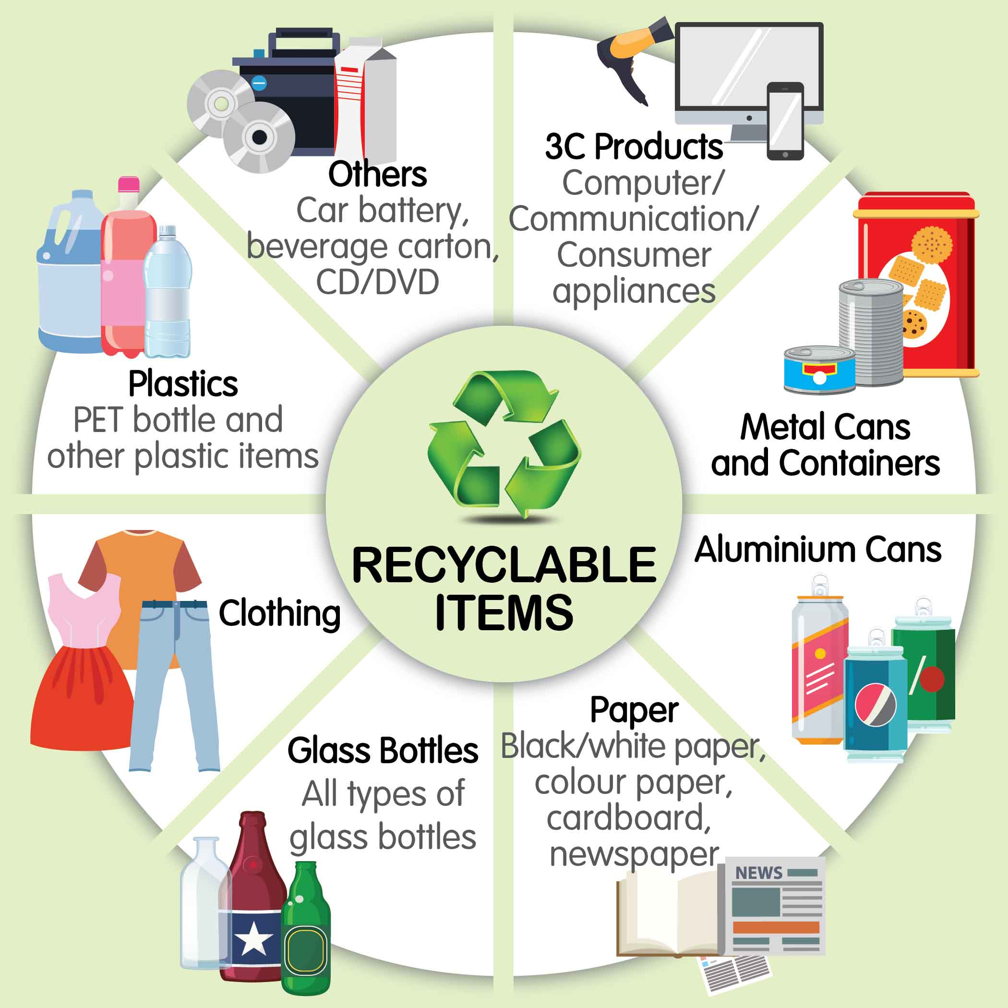
Green Computing
How to safely dispose of obsolete computers
Many states have recycling programs
Some manufacturers have developed programs
Greenpeace environmental activist organization
Issues quarterly ratings of
manufacturers according to the
manufacturers’ policies on
toxic chemicals, recycling,
and climate change
Manufacturers have long way
to go to meet the high standards

Slide 13
What are the initiatives in Malaysia?

Slide 14
Pathways to Green Computing
Green use
Intelligent use of energy and information system.
Reducing the energy consumption of computers and other systems as well as using them in an environmentally sound manner.
Green Disposal
Reduction of waste, reuse and refurbishment of hardware.
Recycling of out of use peripherals and other items.
Refurbishment and reuse old computers
Proper recycling unwanted computer and other electronic equipment

Slide 15
Pathways to Green Computing
Green design
Efficient design of data centers and workstation.
Design energy-efficient and environmentally sound components, computers, servers, cooling equipment, and data centers.
Green manufacturing
Informed purchasing of components, peripherals, and equipment manufactured with the environment in mind.
Manufacturing electronic components, computers, and other associated subsystems with minimal impact on the environment.

Slide 16
Objective: Digital Divides
What is digital divides?
What is being done to reduce the negative influence of the digital divide?

Slide 17
The Digital Divides
Standard of living
Level of material comfort measured by the goods, services, and luxuries available
Digital divide
Refers to the gulf between some group of people enjoy access to and regularly use the various forms of modern information technology, while others do not
Cell phones
Personal computers
The Internet
Gulf among age groups, economic classes, and cities/rural areas

Slide 18
The Digital Divides
Digital divide must be bridged to improve resolution of:
Health emergencies
Crime emergencies
Other emergencies
Access to IT and communications technology:
Enhances learning
Provides educational and economic opportunities
Influences cultural, social, and political conditions

Slide 19

The Digital Divides
Low-cost computers for developing countries
One Laptop per Child (OLPC)
Provides low-cost laptop computers for education
Classmate PC from Intel
Eee notebook from Asus
Mobile phone
Tool to bridge the digital divide
Costs less than PC and more
broadly available

Slide 20
Objective: Work environment
What are the concern in the workplace related to electronic monitoring?

Slide 21
Work environment: Monitoring
Monitoring concerns in the workplace
Blogging: Blogging represents a possible monitoring risk in the workplace as private thoughts put online can be seen by the anyone. If posting sensitive information and an employer stumbles on to your blog, it is quite possible you could be demoted or fired.

Slide 22
Work environment: Monitoring
Monitoring concerns in the workplace
Time Management: Programs exist that can monitor what webpages you visit on the company's computer. Data analysts can have their performance judged based on how much they type. And when all else fails, video surveillence allows a company to keep records of an employee's activity.

Slide 23
Work environment: Monitoring
Monitoring concerns in the workplace
Privacy Concerns: In addition to being able to monitor what websites you visit, it is also possible and legal for a company to monitor what calls you make from the company phone, and even record the phone call itself.

Slide 24
Work environment: Monitoring
What can be done to protect yourself?
If you have a blog, avoid blogging about work.
If this isn't desirable, try and privatize entries pertaining to work so that only you or a selected list of people can read them.
When blogging about your job, try to be as general as possible - avoid using the company name, names of employers, or specific events or addresses.
Also, blogging under a pseudonym can help keep you hidden.

Slide 25
Work environment: Monitoring
What can be done to protect yourself?
Be aware of your company's policies on all of these issues. Find out what information they record and how often it is checked.
Avoid patently personal use of company time and equipment.

Slide 26
Work environment: Web-Surfing at work
Personal Internet Use at Work
it is not uncommon for everyone to go off on a tangent and surf the web.
Usage aside from work related material range from sending personal email, online shopping, online gaming, chatting, etc.
Usage should be based on the employers’ policy if one is in place.

Slide 27
Objective: Social Media Networking
What are social networks, how do people use them, and what are some of their practical business uses?
What are some of the key ethical issues associated with the use of social networking Web sites?

Slide 28
What Is a Social Networking Web Site?
Creates an online community of Internet users that eliminates barriers created by time, distance, and cultural differences
Allows people to interact with others online by sharing opinions, insights, information, interests, and experiences
Members may use the site to interact with friends, family members, and colleagues they already know
Members may also wish to develop new personal and professional relationships

Slide 29
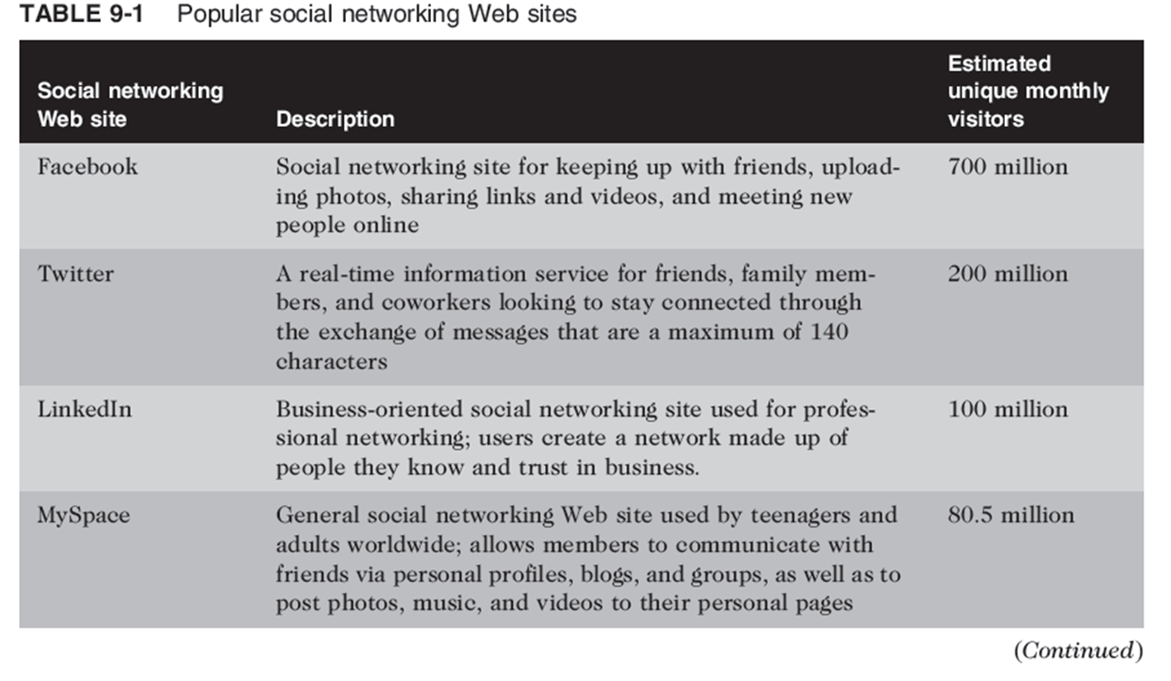
Social Networking Web Site

Slide 30
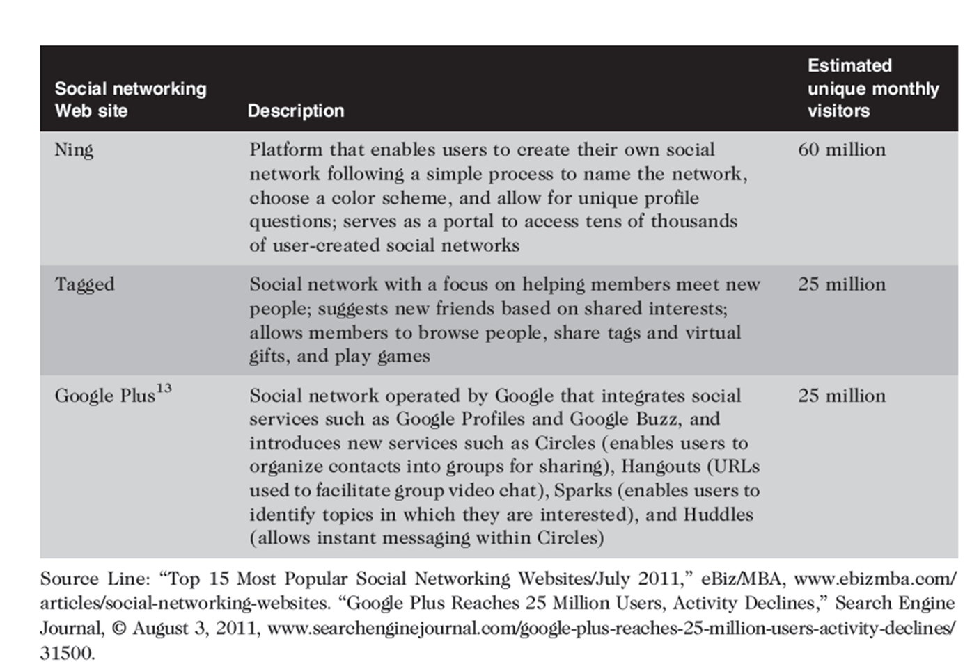
Social Networking Web Site

Slide 31
Business Applications of Online Social Networking
Social network advertising
Uses social networks to communicate and promote the benefits of products and services
Social network advertising strategies
Direct advertising
Banner ads on social networking Web site
Advertising using an individual’s network of friends
People frequently make decisions based on input from their close group of friends
Ethical issues with exploiting an individual’s personal relationships for the financial benefit of a company

Slide 32
Business Applications of Online Social Networking (cont’d.)
Social network advertising strategies (cont’d.)
Indirect advertising through groups
Interested users can join by becoming “fans”
Fans gained in this manner may not remain loyal
Company-owned social networking Web site
Users can talk about what new products, services, or improvements they would like to see
Viral marketing
Users pass along marketing message to others, creating the potential for exponential growth

Slide 33
The Use of Social Networks in the Hiring Process
recruiters use some form of social media in the recruiting process
Employers can and do look at the social networking profiles of job candidates when hiring
Companies may reject candidates who post:
Information about their drinking or drug use
Provocative or inappropriate photos
Discriminatory remarks relating to race, gender, or religion
Confidential information

Slide 34
Use of Social Media to Improve Customer Service
Consumers use social networks to share their experiences, both good and bad, with others
Also seek help and advice on how to use products more effectively and how to deal with special situations
Unless organizations monitor social networks, customers are left to resolve questions and issues on their own, risking loss of customers and future sales

Slide 35
Social Shopping Web Sites
Combine two highly popular online activities: shopping and social networking
Shoppers and sellers can share information and make recommendations while shopping online
Revenue is generated through retailer advertising or by sharing with retailers data about their members’ likes and dislikes
Retailers can design product improvements based on input and get ideas for new product lines
Great way for small businesses to boost sales

Slide 36
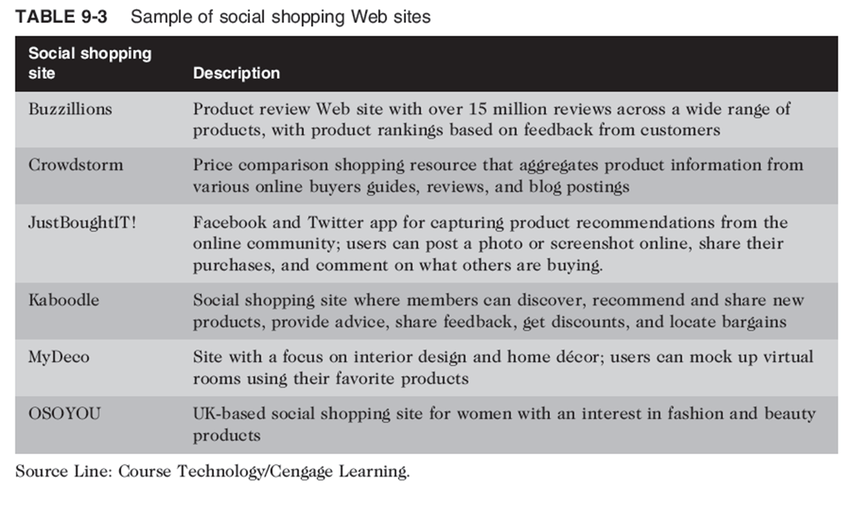

Slide 37
Social Networking Ethical Issues
Ethical issues for social networking Web sites are:
Cyberbullying
Cyberstalking
Sexual predators
Uploading inappropriate material
Cyberbullying
Harassment, torment, humiliation, or threatening of one minor by another minor or group of minors via the Internet or cell phone
Cyberbullying can become so intense, child commits suicide

Slide 38
Social Networking Ethical Issues (cont’d.)
Numerous forms of cyberbullying
Sending mean-spirited or threatening messages
Sending thousands of text messages to victim’s cell phone and running up a huge cell phone bill
Impersonating victim and sending inappropriate messages to others
Stealing victim’s password and modifying his or her profile to include racist, homophobic, sexual, or other inappropriate data that offends others or attracts the attention of undesirable people

Slide 39
Social Networking Ethical Issues (cont’d.)
Numerous forms of cyberbullying (cont’d.)
Posting mean, personal, or false information about the victim in the cyberbully’s blog
Creating a Web site whose purpose is to humiliate or threaten the victim
Taking inappropriate photos of the victim and either posting online or sending to others via cell phone
Setting up an Internet poll to elicit responses to embarrassing questions regarding victim
Sending inappropriate messages while playing interactive games

Slide 40
Social Networking Ethical Issues (cont’d.)
Cyberstalking
Threatening behavior or unwanted advances using the Internet or online and electronic communications
Adult version of cyberbullying
Can escalate into:
Abusive or excessive phone calls
Threatening or obscene mail
Trespassing
Vandalism
Physical stalking
Physical assault

Slide 41
Social Networking Ethical Issues (cont’d.)
Uploading of inappropriate material
Social networking Web sites have policies against uploading videos depicting violence or obscenity
Most social networking Web sites have terms of use agreements that give the sites the right to delete material and terminate users accounts that violate their policy
Most Web sites do not have sufficient resources to review all material posted

Slide 42
Evaluating Information
Does the openness of the web increase distribution of useful or inaccurate, foolish, and biased information?

